Slide 1
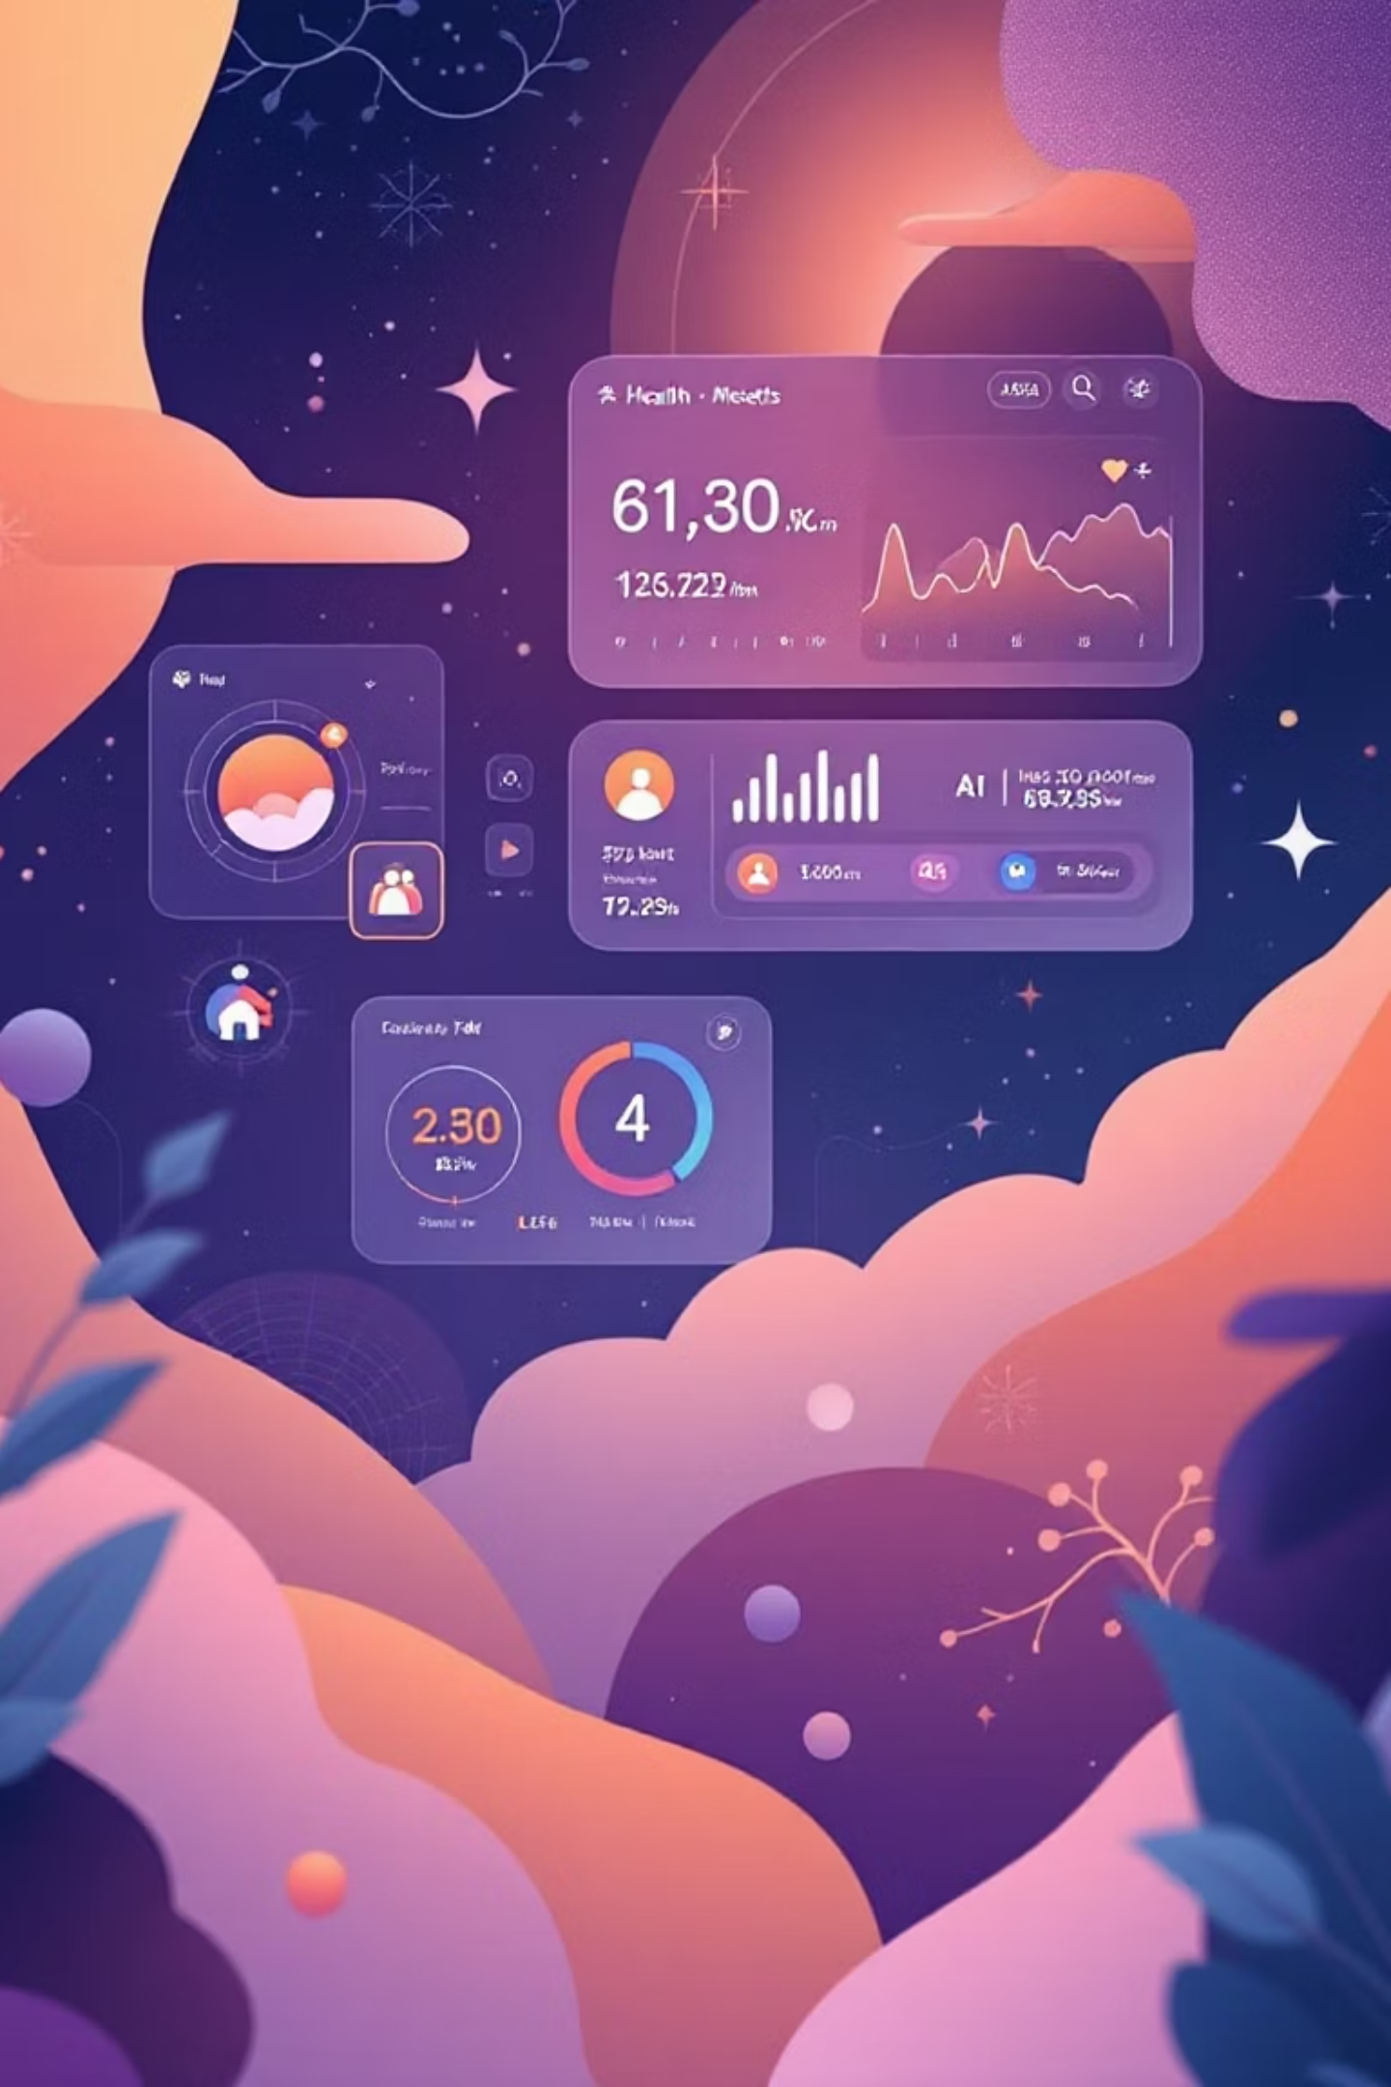

HealthScope AI: Decoding Your Health Reports
From Data to Actionable Health Intelligence
Transforming complex health reports into personalised, actionable insights through intelligent analysis and AI-powered recommendations.

Slide 2

Health Reports Are Overwhelming, Not Illuminating
You receive a blood test back with 30+ markers. Your cholesterol is elevated, Vitamin D is low. What does it actually mean for you?
Information Overload
Pages of complex medical data are difficult to interpret without medical expertise.
Lack of Context
Numbers without explanation create anxiety and confusion about health status.
Unawareness of potential disease
what does these number implies? What potential risk I have in future ?
This gap between data and understanding leads to inaction and poor health outcomes.

Slide 3
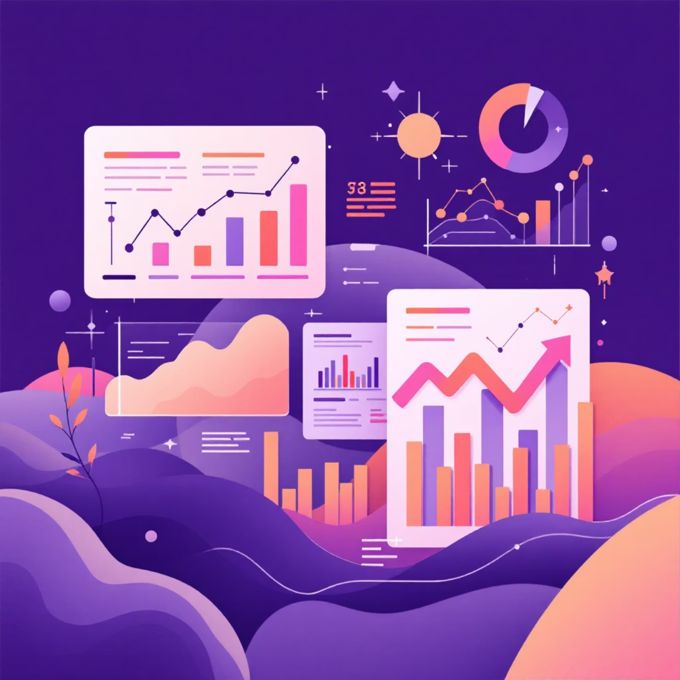



The Need Isn't More Data, It's Smarter Analysis
Our research reveals that 72% of people feel anxious after receiving a health report and don't know the next steps.
The insight: A system is needed that doesn't just present data, but connects the dots between different health markers.
Intelligent
Personalised
Using rules to identify correlations and patterns a human might miss.
Providing recommendations specific to the individual's results.
Action-Oriented
Translating complex data into simple, clear steps.

Slide 4
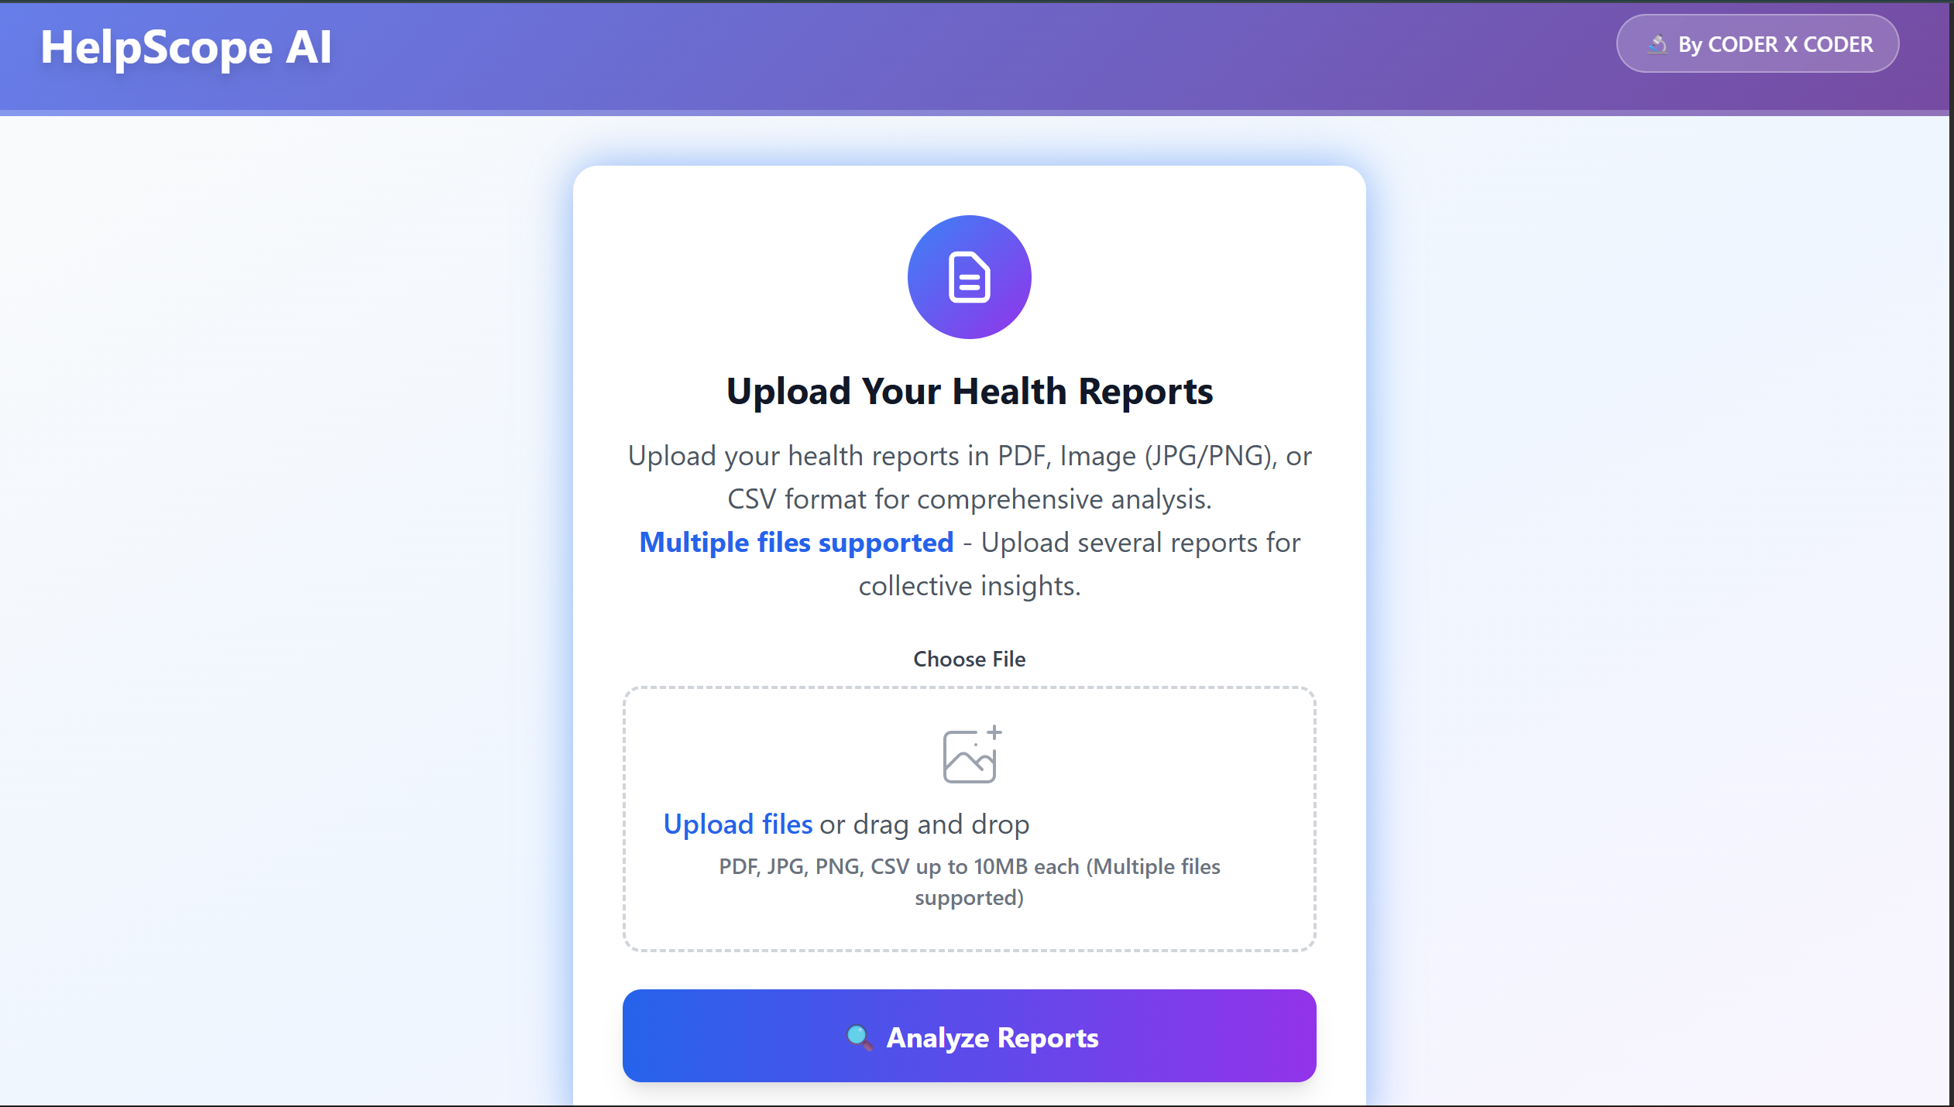
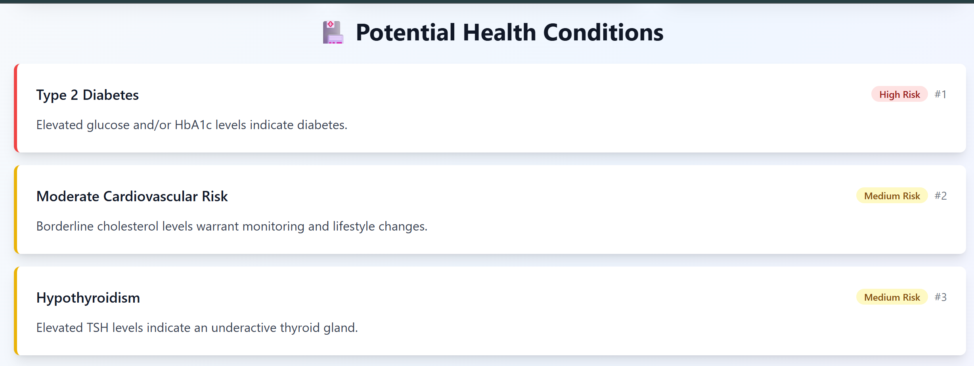
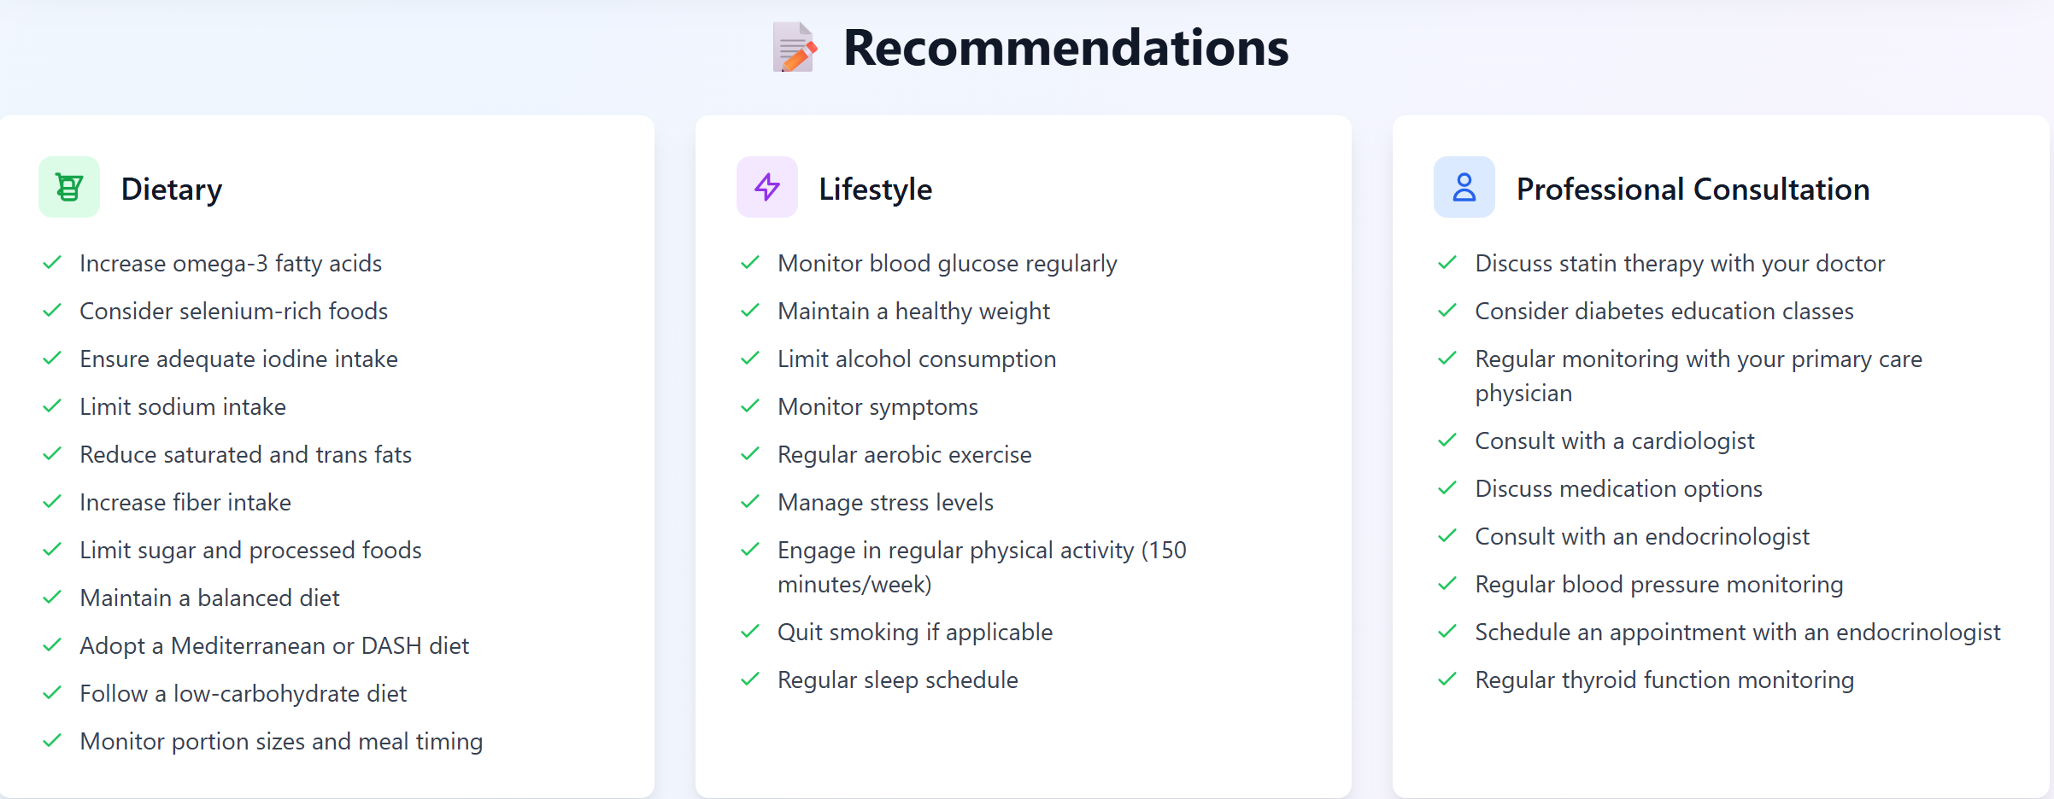






Your Personal Health Analyst, Powered by AI
We built HealthScope, a powerful rule-based engine that analyses multiple health markers to predict risks and provide personalised guidance.
Multi-Format Input
Actionable Insights
Holistic Health View
Seamlessly analyse reports from any source. We accept uploaded Images (photos of reports), PDFs (lab digital reports), and CSVs (wearable data).
We go beyond numbers. Get clear, immediate advice on Dietary changes, Lifestyle adjustments, and guidance on When to consult a doctor.
See the big picture. Our dashboard synthesises all your results into one comprehensive overview, tracking trends over time.

Slide 5


Building a Healthier Future, Together
1
Next 6 Months
Closed Beta launch with select healthcare providers
Integrate with major wearable APIs (Apple Health, Fitbit)
2
Next 12 Months
Develop predictive analytics for chronic condition management
Launch B2B API for clinics and wellness apps
3
Long-Term Vision
Become the universal standard for personalised, preventative health intelligence.
We are seeking partners and investors to help us scale. Let's connect and transform healthcare together.

Slide 6





Thank You!
We envision a future where complex health data becomes clear, actionable insights for everyone. Your partnership is key to building this healthier tomorrow.
Email Us
Visit Our Website
info@healthscopeai.com
healthscopeai.com
Call Us
Connect on LinkedIn
+91 9352856490
@HealthScopeAI

